Slide 1


How can we make resource-constrained IoT networks more efficient?
Dr. Alakesh Kalita
IIT (ISM) Dhanbad, India.

Slide 2
What is Internet of Things?
Things + Internet = Internet of Things
“Things” can be
TV, Fridge, Camera, almost every physical thing in the world
To be a thing, an entity should
Have the sensing capacity
by itself
adding external sensors
Sometimes, works as actuator
Communication

Slide 3
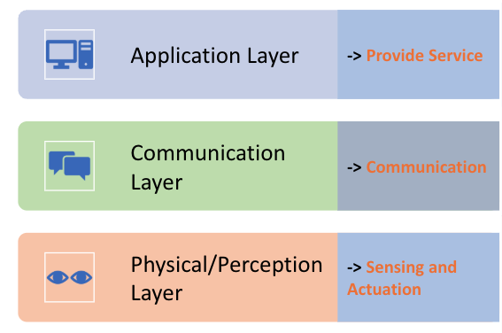
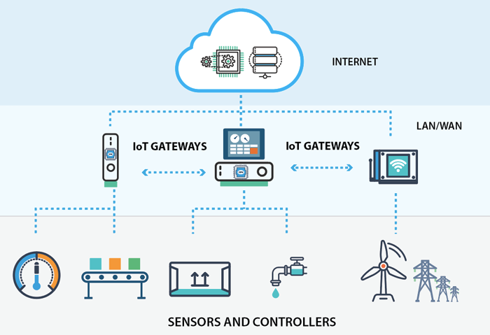
Basic layers of IoT architecture

Slide 4
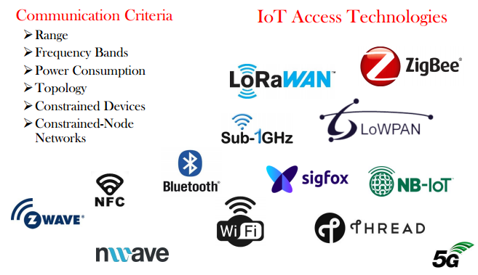
Different communication technologies
Communication Criteria
Communication Range
Frequency band
Power Consumption
Topology
Device type
Communication technologies
6TiSCH

Slide 5
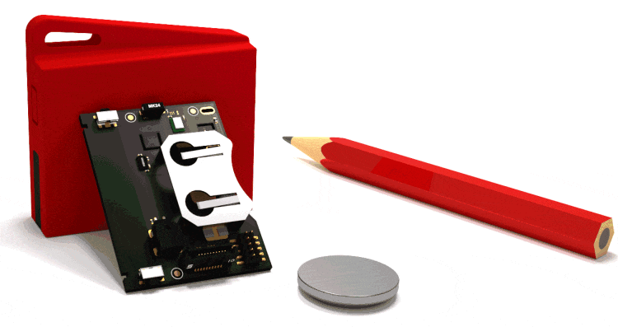
Device type and Application requirements
Devices are resource-constrained,
Processing capacity, (RAM in KBs)
Memory (in KBs), and
Energy (small battery).
Fig: TI CC2650 SensorTag
Requirements of critical IoT applications such as smart healthcare, fire safety, etc.,
Bounded latency,
Reliability,
Scalability, and
Energy efficiency

Slide 6
IEEE 802.15.4 (ZigBee) Vs 6TiSCH Networks
IEEE 802.15.4 (2003) fails to provide the demands of critical application, because of
Usage of CSMA/CA
Single channel
As a result, IEEE 802.15.4e was released in 2008
To re-design the existing IEEE 802.15.4 MAC
It introduces five new MAC behaviour modes to support different applications
One of these MAC behaviour modes is Time Slotted Channel Hopping (TSCH)
IETF created 6TiSCH working group (WG) in 2012 to provide
Interoperability between IEEE 802.15.4e TSCH and existing IPv6 protocol stack for LLNs

Slide 7
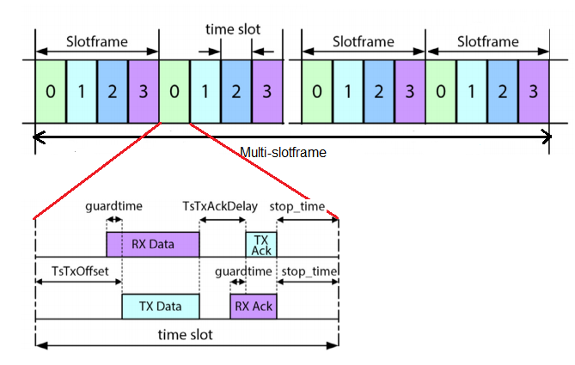
6TiSCH Networks
Topology Independent
Work with any network topology
Star, Mesh, Bus
One hop and Multi hop
Time Slotted Channel Access (TSCH)
Increase throughput by eliminating collision among competing nodes
Predictable and bounded latency

Slide 8
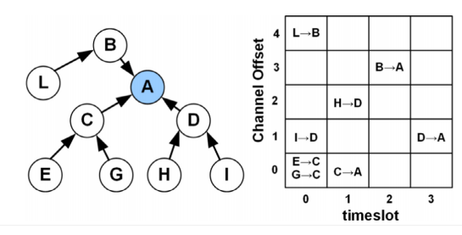
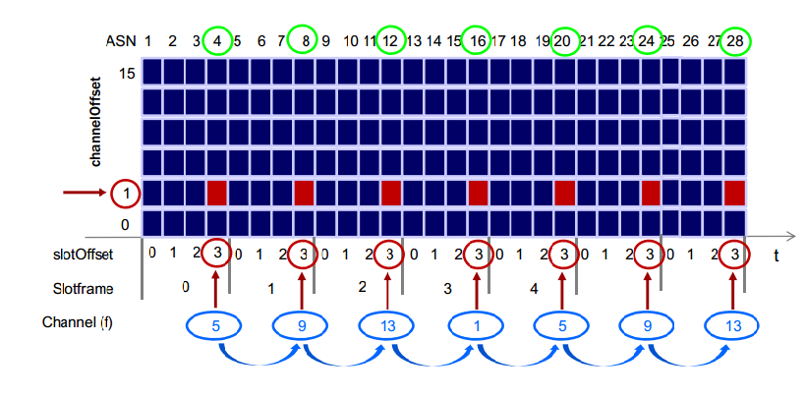
Cont.…
Multi-channel communication
Many nodes can exchange their frames at the same time
Increases network capacity
Channel Hopping
Mitigates the problems of interference and multipath fading
Improve reliability

Slide 9
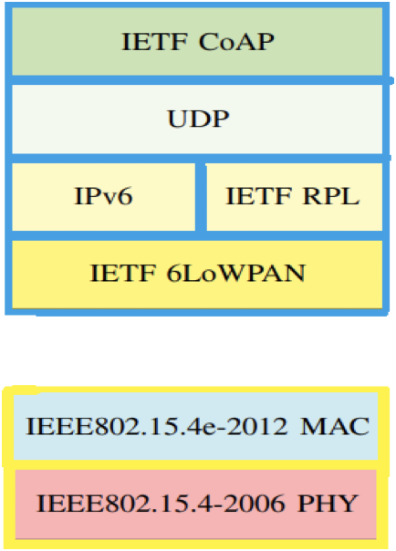
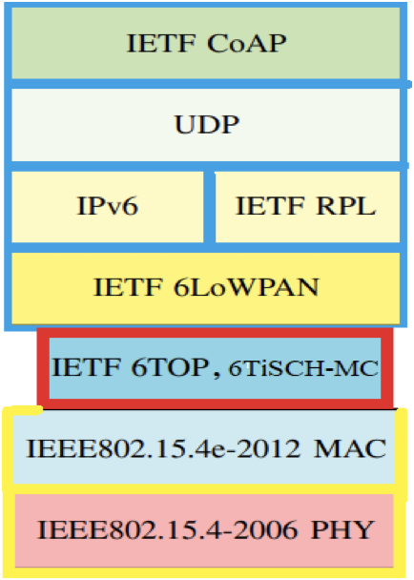
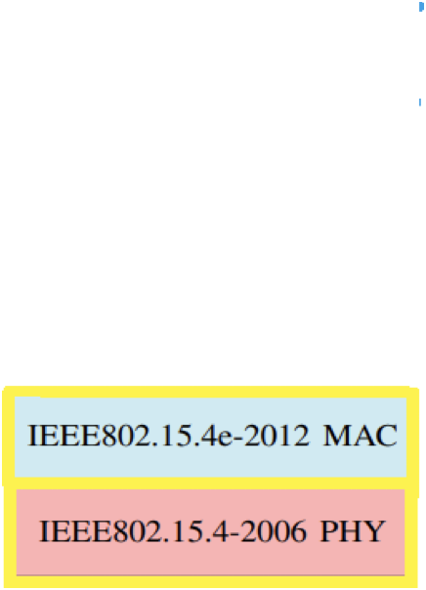
6TiSCH Communication Stack
Upper Layer: IPv6 connectivity
6LoWPAN (RFC 8138), CoAP (RFC 7252), RPL (RFC 6550)
6TiSCH Layer
RFC 8180, 6top (RFC 8480)
Bottom Layer: IEEE 802.15.4e, 2015
TSCH (MAC mode)

Slide 10
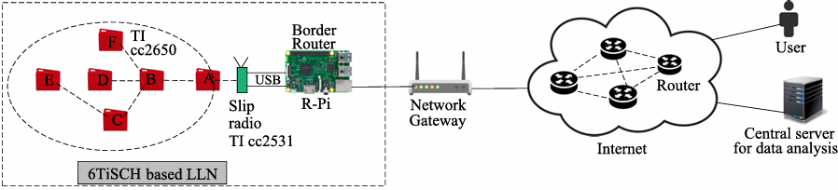
6TiSCH Network
Fig: A 6TiSCH network in connected to the Internet

Slide 11
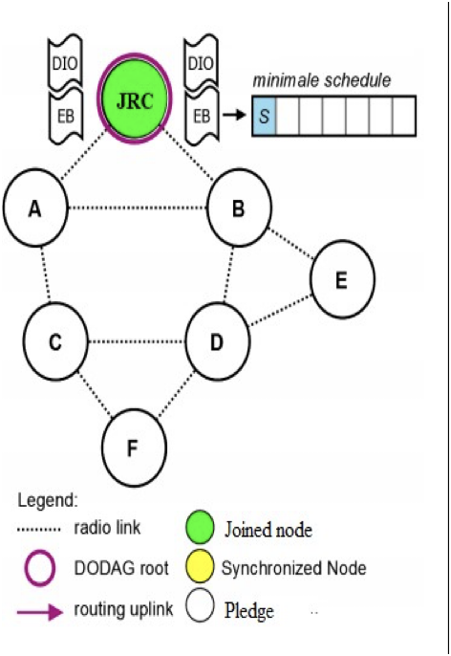
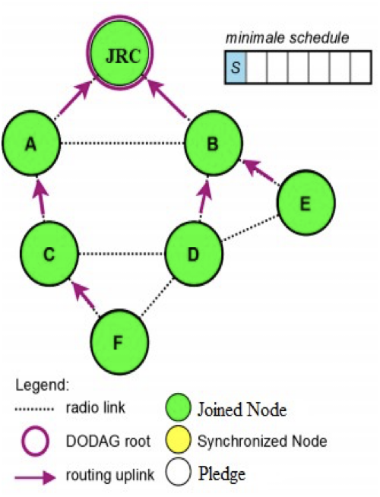
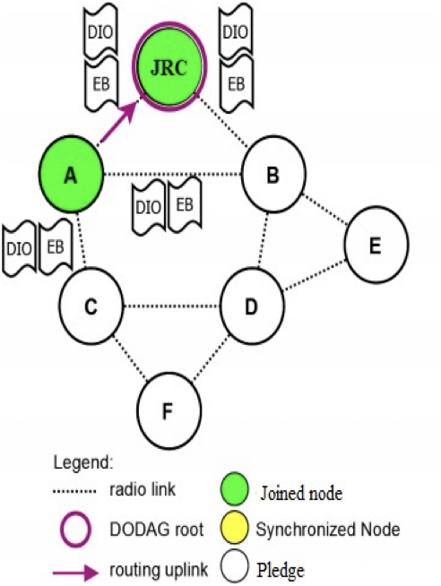
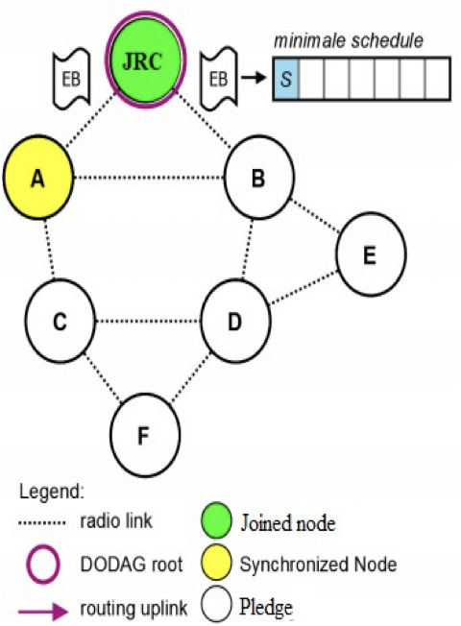
6TiSCH Network Formation Process
Join Registrar/Coordinator (JRC) starts the formation process
Enhanced Beacon (EB)
Routing Information (DIO)
Pledge (new node) scans for EB on a random channel (Radio Duty Cycle (RDC) 100%)
After receiving an EB, pledge synchronized with the underlying TSCH network (RDC ~1%)
Now wait for routing information carrying packet, DIO
Becomes a joined node after receiving DIO packet

Slide 12
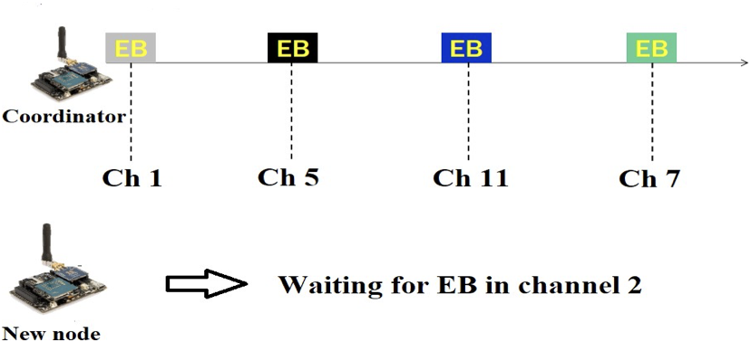
Issues in 6TiSCH Network Formation
Channel hopping feature of TSCH
A pledge does not know in which channel transmission of control packets is happening

Slide 13
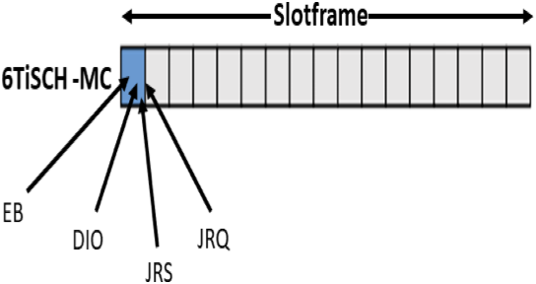
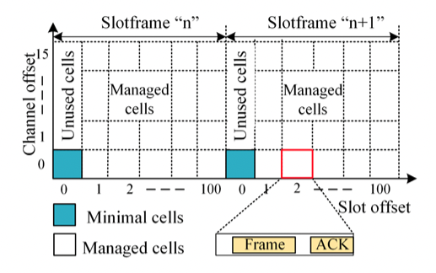
Issues in 6TiSCH Network Formation
Limited resource allocated for control packets (RFC 8180)
Only one shared cell in a slotframe
Use CSMA/CA to transmit control packet in shared cells
EB’s are transmitted frequently but DIOs are not.
Underutilization of all the channel
No co-operation among the nodes to transmit their control packets
+++

Slide 14
Improve the efficiency of 6TiSCH network
Faster formation of 6TiSCH network helps in
Increasing network lifetime
Efficient data packet transmission
Reliability
E.g., nodes deployment during rescue operation, a patient admitted in smart healthcare system

Slide 15
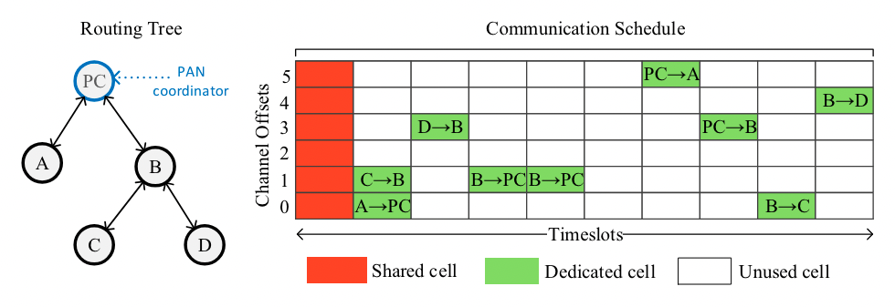
Data transmission in 6TiSCH Network
The communicating nodes (sender and receiver) must schedule cells for data transmission
Unused cells

Slide 16
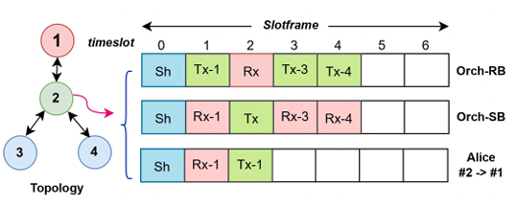
Methods and issues in cell scheduling
Centralized approach: PC decides the scheduling for all the nodes
Control packet overhead
Central node failure
Distributed approach: A pair of nodes decides their cells
Control packet overhead
Possibility of cell overlapping
Autonomous approach: Nodes autonomously decide their cells
Possibility of cell overlapping
Most widely used but hard to make it more dynamic or adaptive

Slide 17
Advantage of efficient cell scheduling
Improves reliability
Less packet collision
Better throughput
Bonded latency
Reduce energy consumption
Minimum number of re-transmission
Reduce control packet overhead

Slide 18
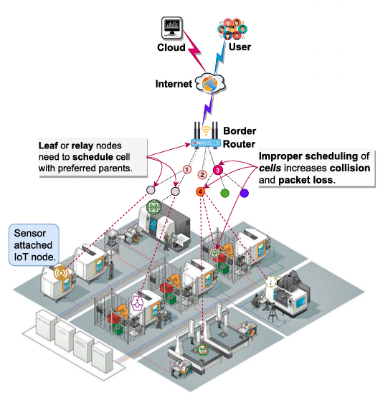
Issues in RPL Routing (RFC 6550)
Root
C
A
Relay
B
Leaf
Logical Routing tree

Slide 19
Issues in RPL Routing
Root
Root
C
C
A
Relay
A
Relay
B
B
B
Leaf
Leaf
Logical Routing tree

Slide 20
Cont.…
Load balance issue can
Increase packet collision
Reduce throughput
Increase packet latency
Reduce lifetime of the network
Root
C
A
Relay
Malicious node
B
B
Malicious node can impose
DIS Flooding Attack (DFA)
Sinkhole Attack (SHA)
Selective Forwarding attack (SFA)
Jamming attack etc.,
Leaf

Slide 21
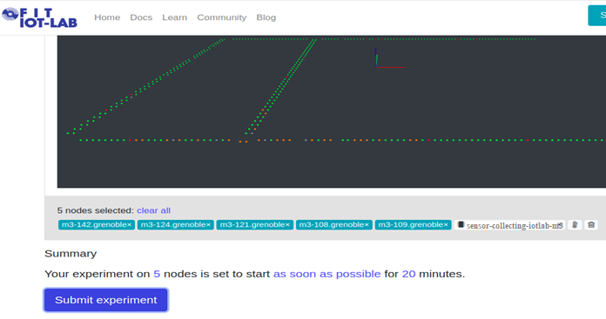
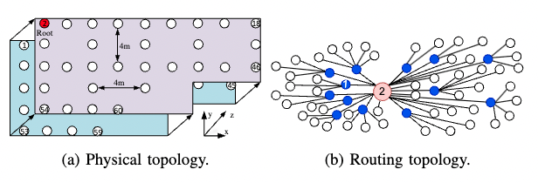
Experimental setup
Recently, we performed testbed experiments by imposing few routing attacks on
FIT-IoTLAB testbed
Open source IoT Testbed

Slide 22
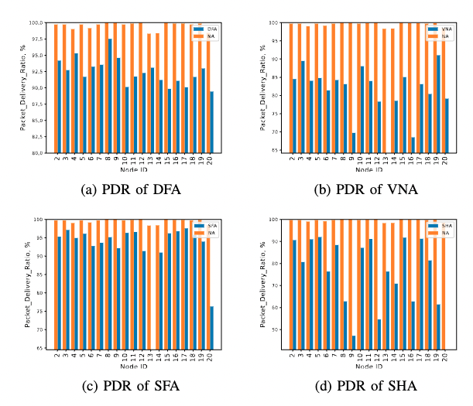
Experimental Results
We found that
Packet delivery ratio (PDR) has significantly dropped
Increases energy consumption
Increases packet latency

Slide 23
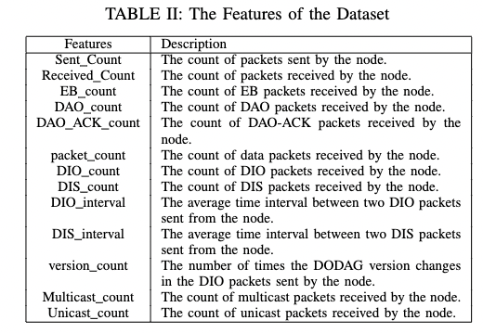
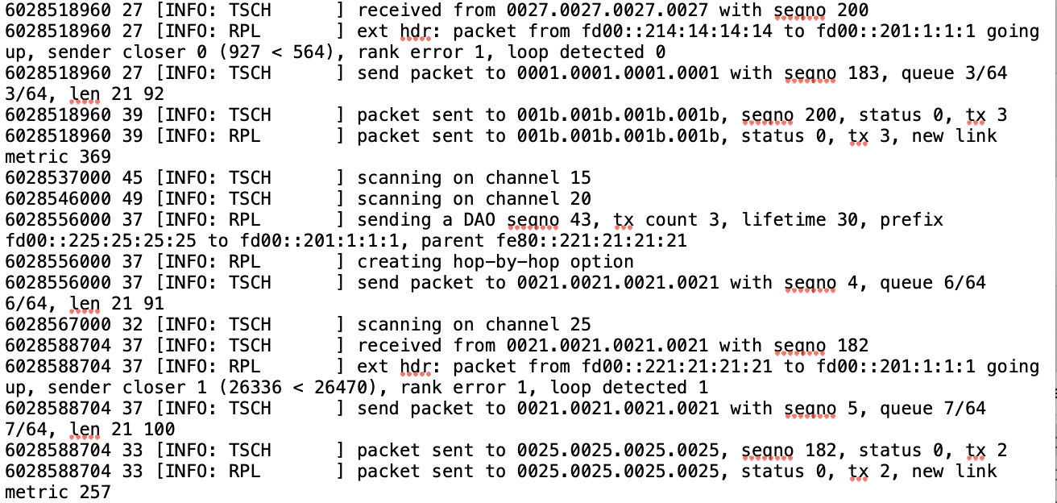

How to detect routing attacks
Machine Learning (ML) cannot be used
Because of the resource-constrained IoT devices
Nodes cannot transmit their information to the root
Energy consumption and overhead issue
Node-packet level information
Process
Dataset

Slide 24
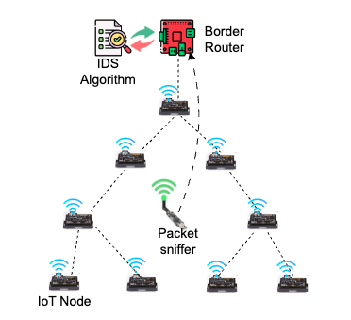
A simple IDS resource-constrained IoT
Capture the packet level information
Forward it to the root node
Assumed to have enough energy resource
Root node use ML algorithms for detection

Slide 25
Basics of Contiki NG
Operating System

Slide 26
What is Contiki OS?
Contiki OS is an open source Operating System for Internet of Things
runs on tiny low-power microcontrollers
It allows to develop applications for different hardware platforms
Using BLE and IEEE 802.15.4 wireless communication standards

Slide 27
How to install Contiki-NG
The latest version of Contiki is known as Contiki-NG (Contiki Next Generation)
Complete installation procedure of Contiki-NG on Linux can be found at the below link,
https://github.com/contiki-ng/contiki-ng/wiki/Toolchain-installation-on-Linux
One can install Contiki-NG using Virtual Box/Docker on Windows OS/MacOS.

Slide 28
Cooja Simulator
Contiki NG has open-sourced the Cooja IoT Network Simulator.
Cooja is a Java-based network simulator
To perform IoT network simulations
Allows large and small networks of motes can be simulated at hardware level
It allows developers to test their code and systems before running it on the target hardware
The same firmware based on Contiki NG OS can be used for both Simulation and testbed experiments.

Slide 29
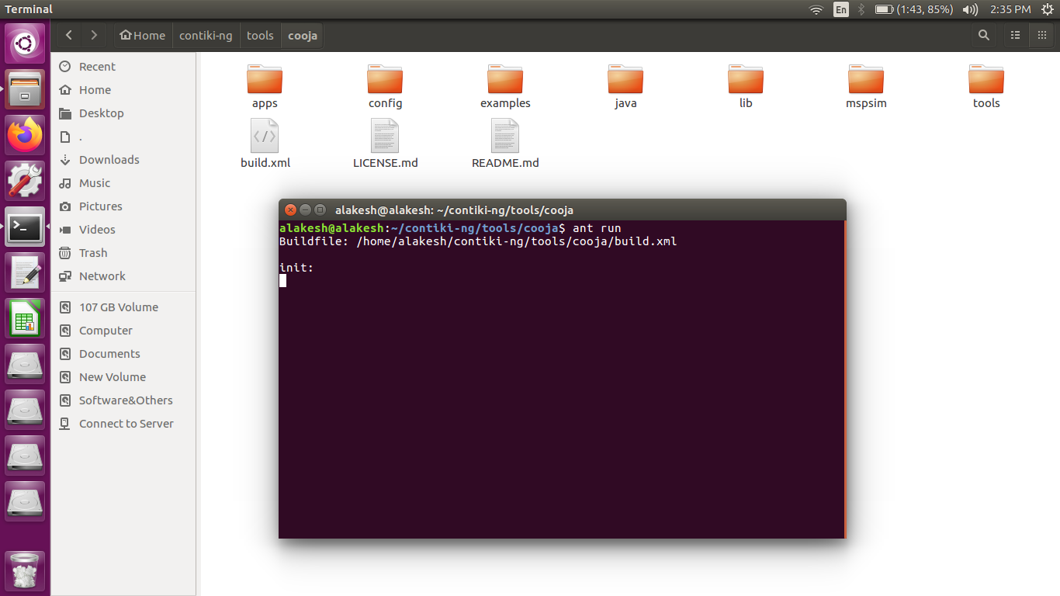
How to start Cooja?
After Contiki-NG installation, start Cooja Simulator using the command “ant run” inside the Cooja directory of Contiki-NG.
Location of your Cooja simulator
ant run

Slide 30
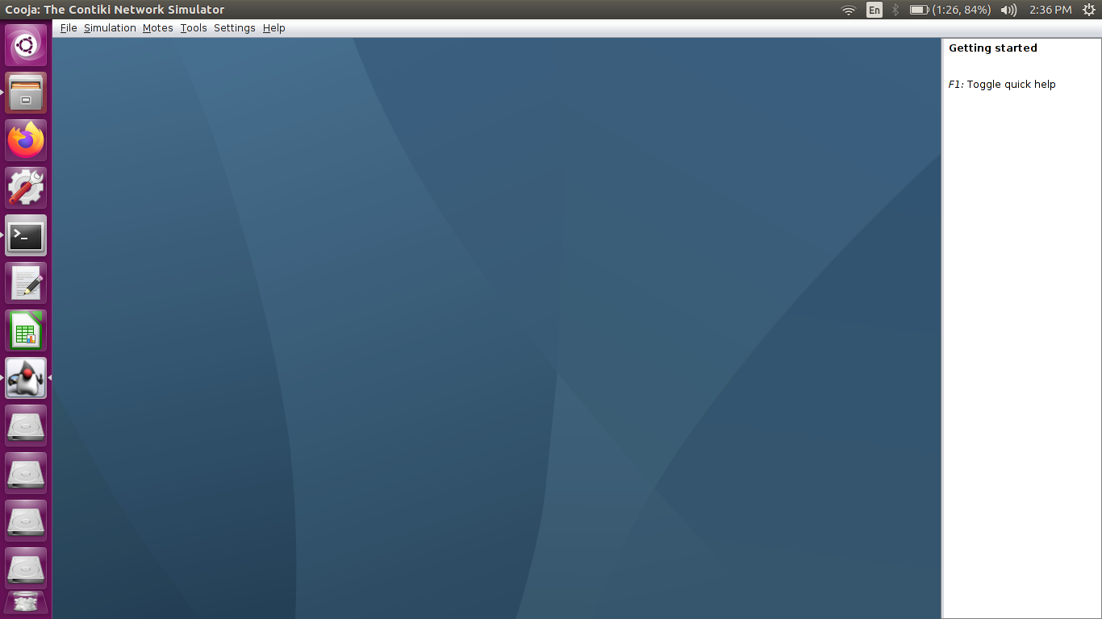
First interface after the starting of the simulator
In the “File” Tab, “Create a new simulation” option is available, which needs to be done first
One can upload the previously stored simulation using the same “File” Tab

Slide 31
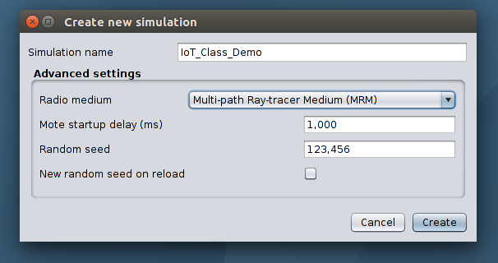
Create a new Simulation
Simulation Name
Select radio medium
UDGM
MRM
MRM gives more realistic
environment for simulation
To create the simulation

Slide 32
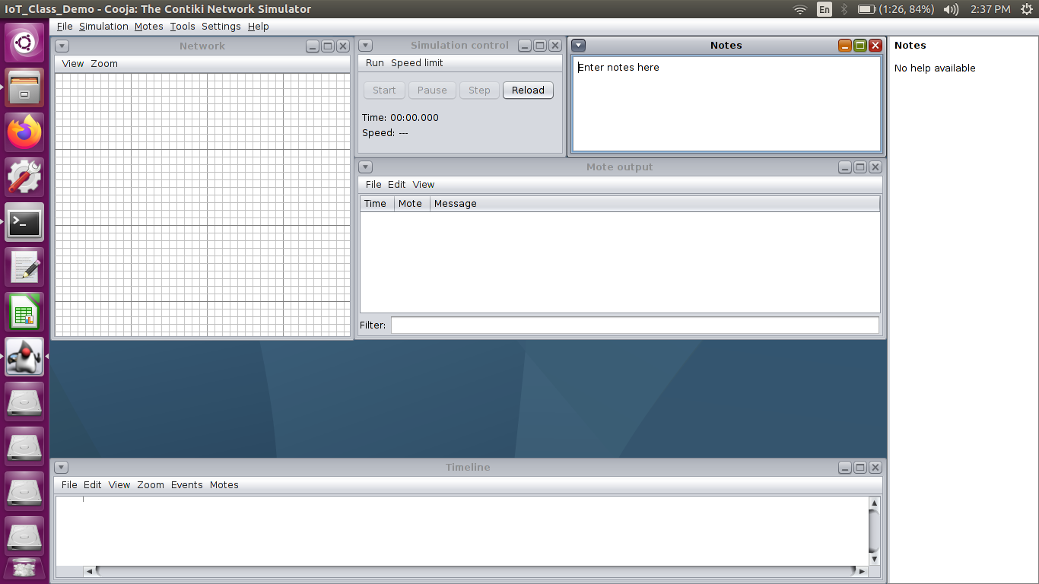
Basic Simulation Interface
Simulation Control area
Motes (nodes) are shown in
this window
Motes can be arranged as
per desired topology
Radio range of the motes
can be adjusted here.
This window shows each and every activities of each motes; printouts serial port information
This window shows the timeline of the motes; shows communication events

Slide 33
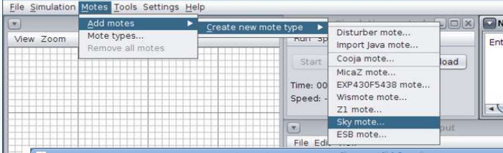
How to add motes (nodes)?
Before simulation, motes need to be added
In the “Motes” tab, click on “Add motes”
Next, click on “Create new mote type” and select the desired available mote (e.g., Cooja mote, sky mote)
Better to use “Cooja” mote on low configuration system

Slide 34
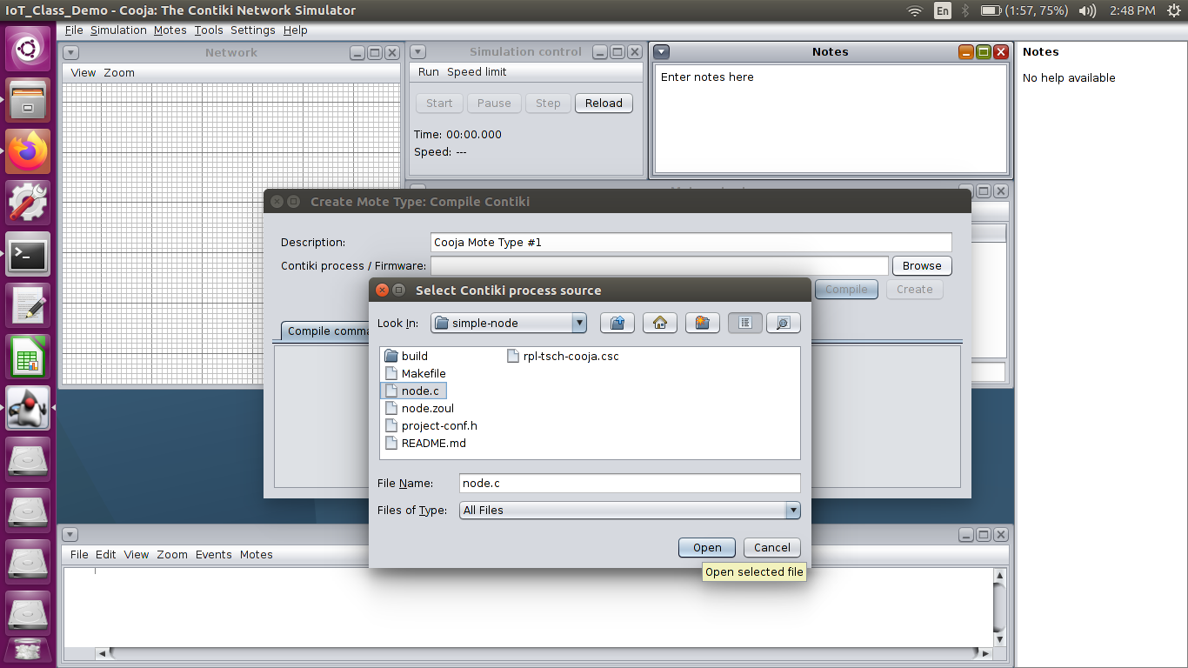
Select the source file
Browse the source file that you want to simulate
In the “example” folder of Contiki-NG, various source files are available
Select the “node.c” file to compile and then simulate
Source File

Slide 35
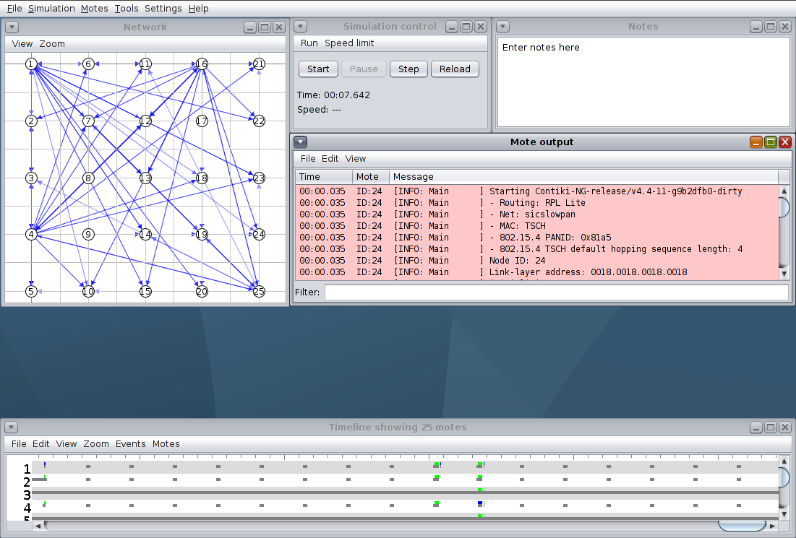
Interface during simulation-1
Event timeline
Motes activity

Slide 36
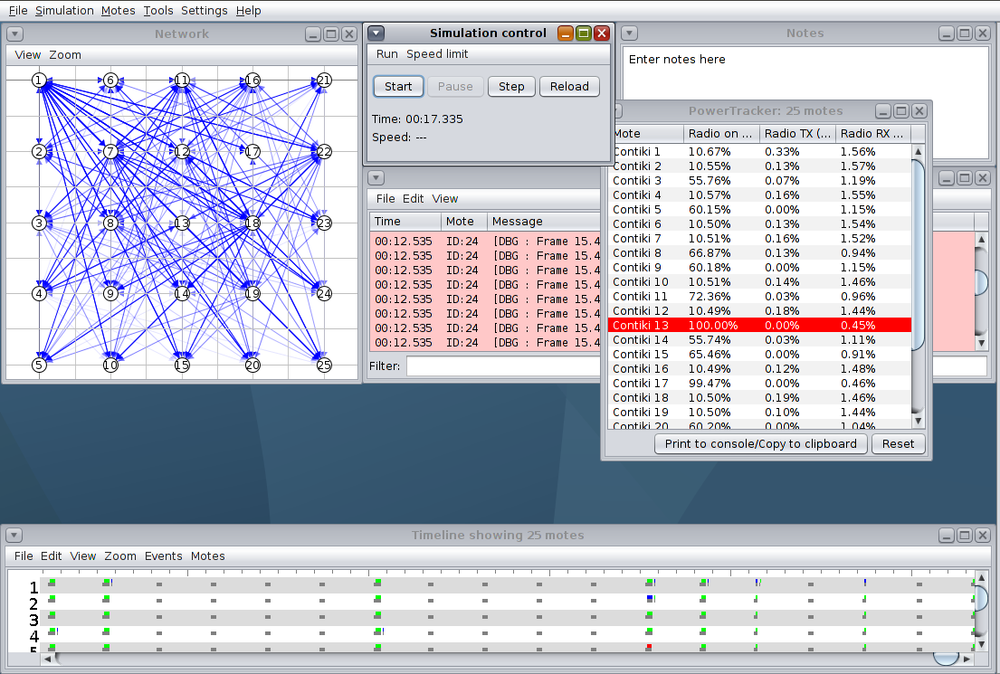
Interface during simulation-2
Nodes can change their positions to anywhere
Simulation
Saving option for nodes activities logfile under the “File” tab
Radio duty cycles of nodes in different radio states
Under “Tool” tab, it is available

Slide 37
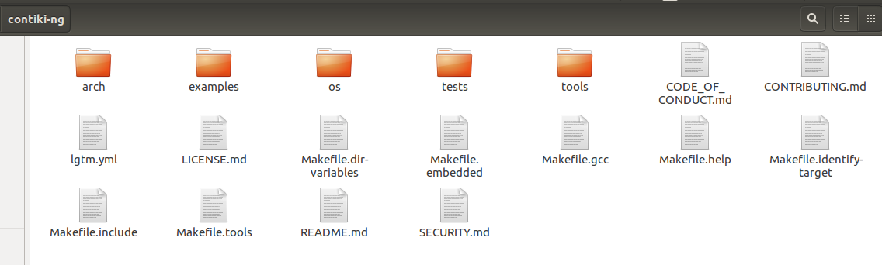
File Organization in Contiki-NG
Implementation of the IoT protocol stack

Slide 38

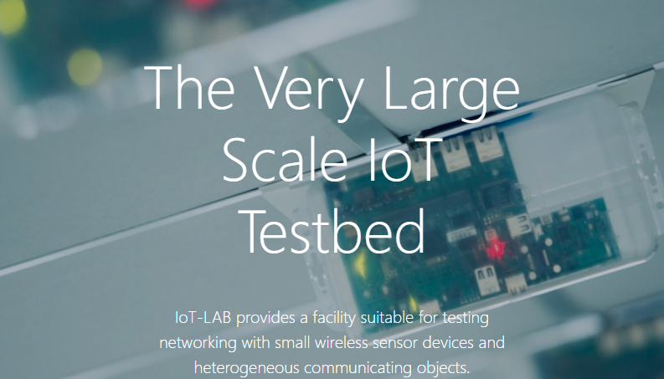

Slide 39
What is FIT IoT-LAB?
FIT IoT-LAB is a real open source IoT Testbed, can be accessible over Internet
where, real physical nodes are deployed
provides a very large scale infrastructure for testing
small wireless sensor devices
and heterogeneous communicating objects.
FIT IoT-LAB features over 1500 wireless sensor nodes spread across six different sites in France.
Nodes are either fixed or mobile and can be allocated in various topologies throughout all sites
Node are with different processor architectures (MSP430, STM32 and Cortex-A8) and different wireless chips (802.15.4 PHY @ 800 MHz or 2.4 GHz)

Slide 40
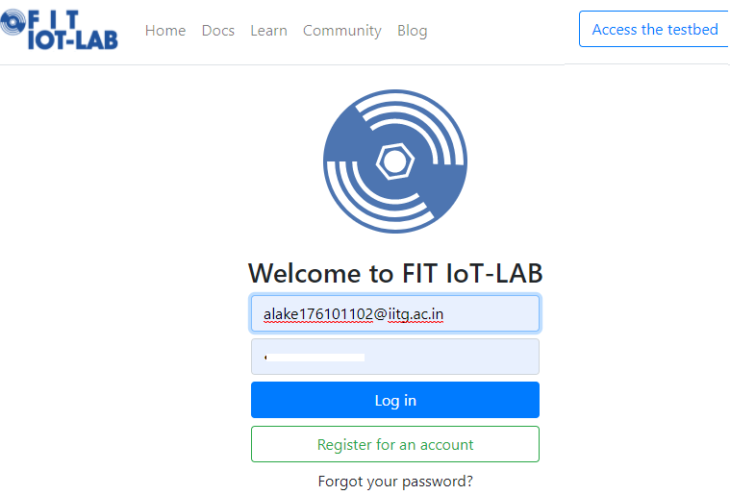
How to access FIT IoT-LAB?
FIT IoT-LAB is available on https://www.iot-lab.info/
To access the testbed, one should create his/her account in FIT IoT-LAB

Slide 41
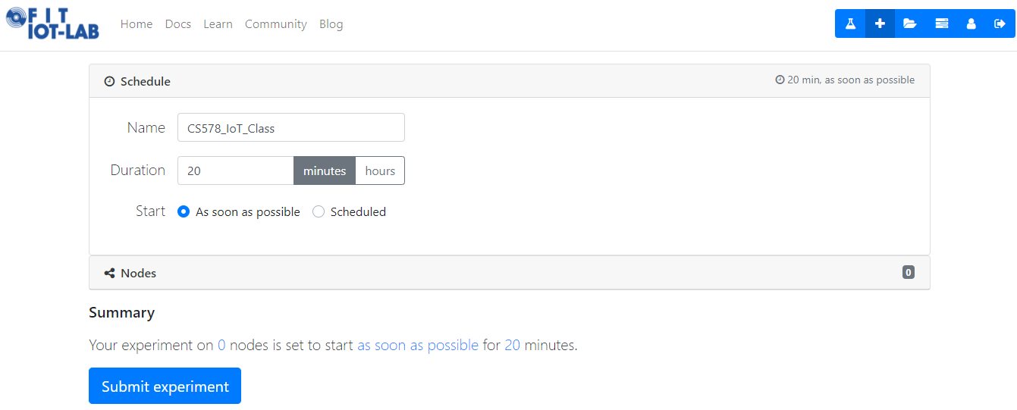
How to perform an experiment?
To create and perform a new experiment, user needs to create new experiment.
To create new experiment
Name of the experiment
Duration of the experiment
User can schedule experiments if nodes are not available at that moment
Nodes need to be selected before submitting the experiment
User can submit his/her experiment once the nodes are selected

Slide 42
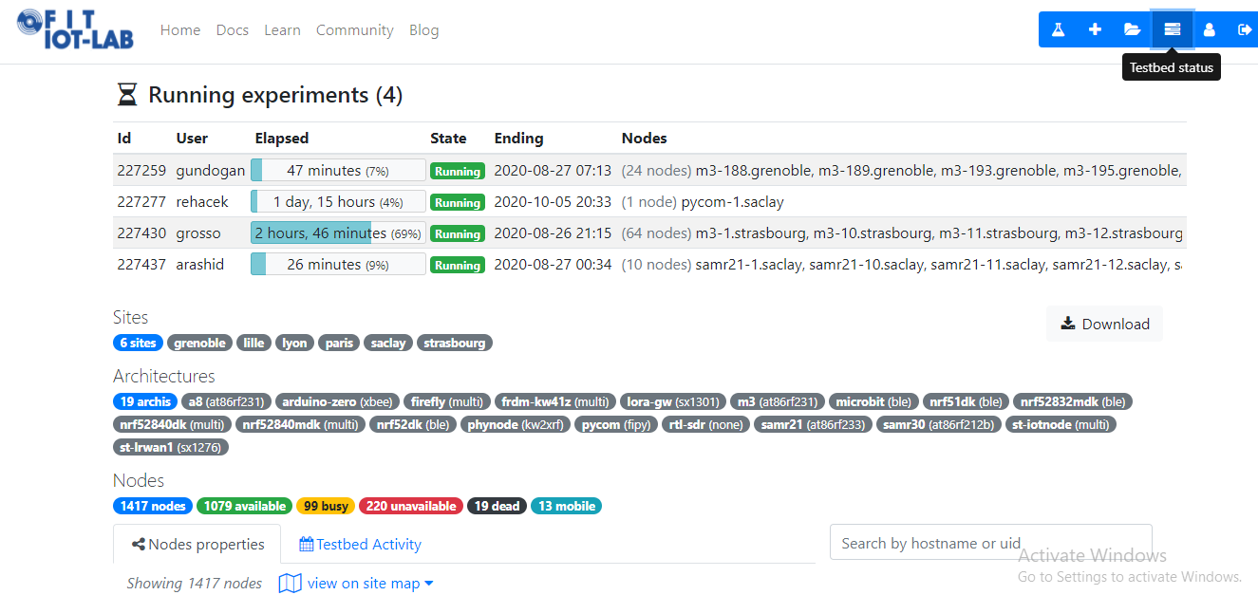
Testbed Status: after login
To create new experiment
Different location where the nodes are present
Architecture of nodes
Status of available nodes in different location

Slide 43
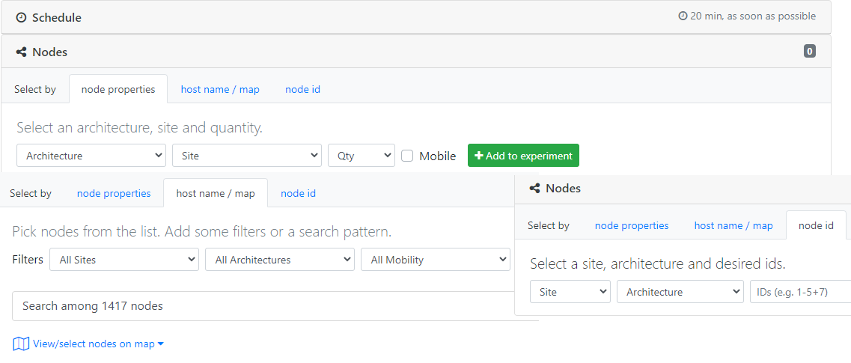
How to select nodes
User can select nodes by Node properties, Host name/map and Node Id
Select the sites
such as grenoble, Lille, Lyon, etc.,
Select the architecture such as M3, A8 etc.,
Selects nodes mobilities i.e., mobile or not mobile

Slide 44
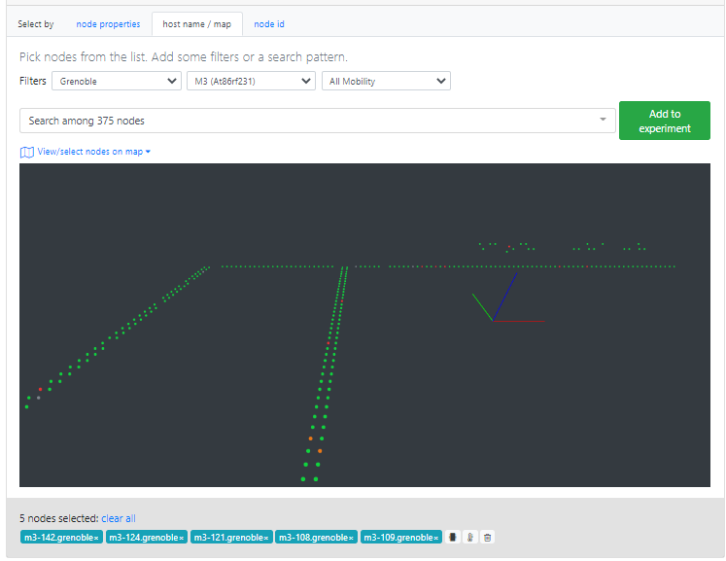
Contd..
Five M3 nodes are selected in Grenoble location. The greed dots denote active nodes, red dots denote the nodes which are down and the blank dots denote the location of the selected nodes
Here, the user firmware needs to be attached

Slide 45
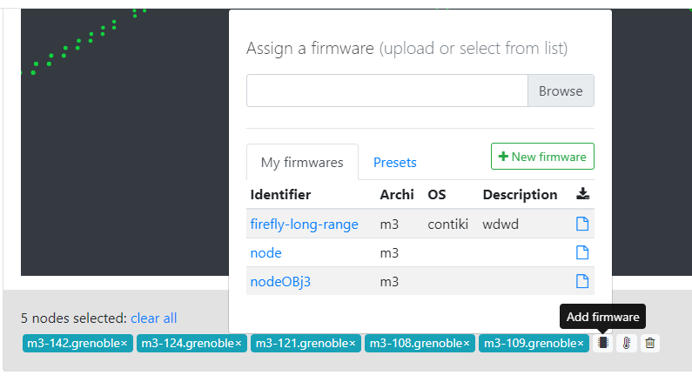
Cont..
Firmware is the binary file (.elf) generated using the contiki-NG.
User can upload his/her modified code for example change in scheduling algorithm, change in RPL operation, change in TSCH operation etc.
Depending on the type of selected node (M3, A8), the firmware varies.
To select a firmware
To add and store a firmware

Slide 46

Large Language Models (LLMs) in IoT
Turn on the TV !!!
IoT
Turn on the TV.
Set the lights in the living room,
Close the blinds,
Adjust the thermostat to a comfortable temperature,
Turn on the TV and
Navigate to the user’s preferred streaming service
Set up for movie night
LLM

Slide 47
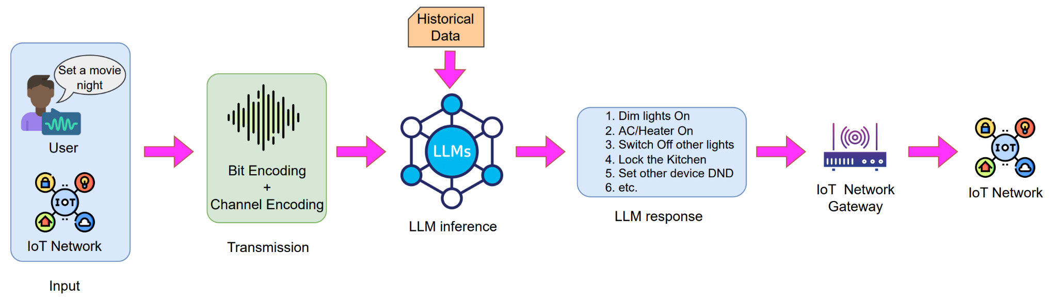
Large Language Models (LLMs) in IoT

Slide 48
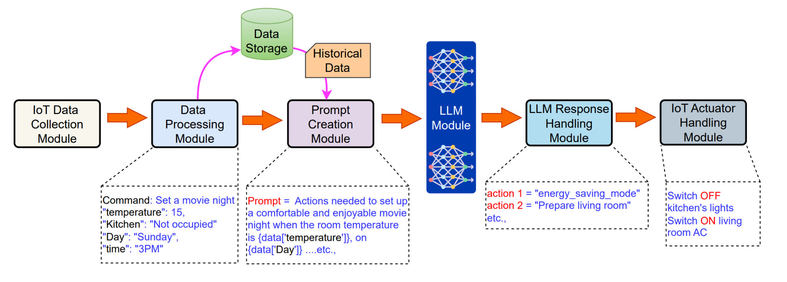
Large Language Models (LLMs) in IoT

Slide 49
Conclusion
Efficiency of the resource-constrained IoT networks can be improved
Improving the nodes joining time
Efficiently and dynamically scheduling data transmission cells
Distributing the network load among the nodes equally
Selecting the routing parent efficiently and
Detecting and mitigating the routing attacks
Using advanced AI technologies

Slide 50

Email: alakesh.kalita1025@gmail.com
https://alakesh-kalita.github.io/

